Slide 1
Zulip New Features
By: Amira, Emily, Shristi, Oriana

Slide 2

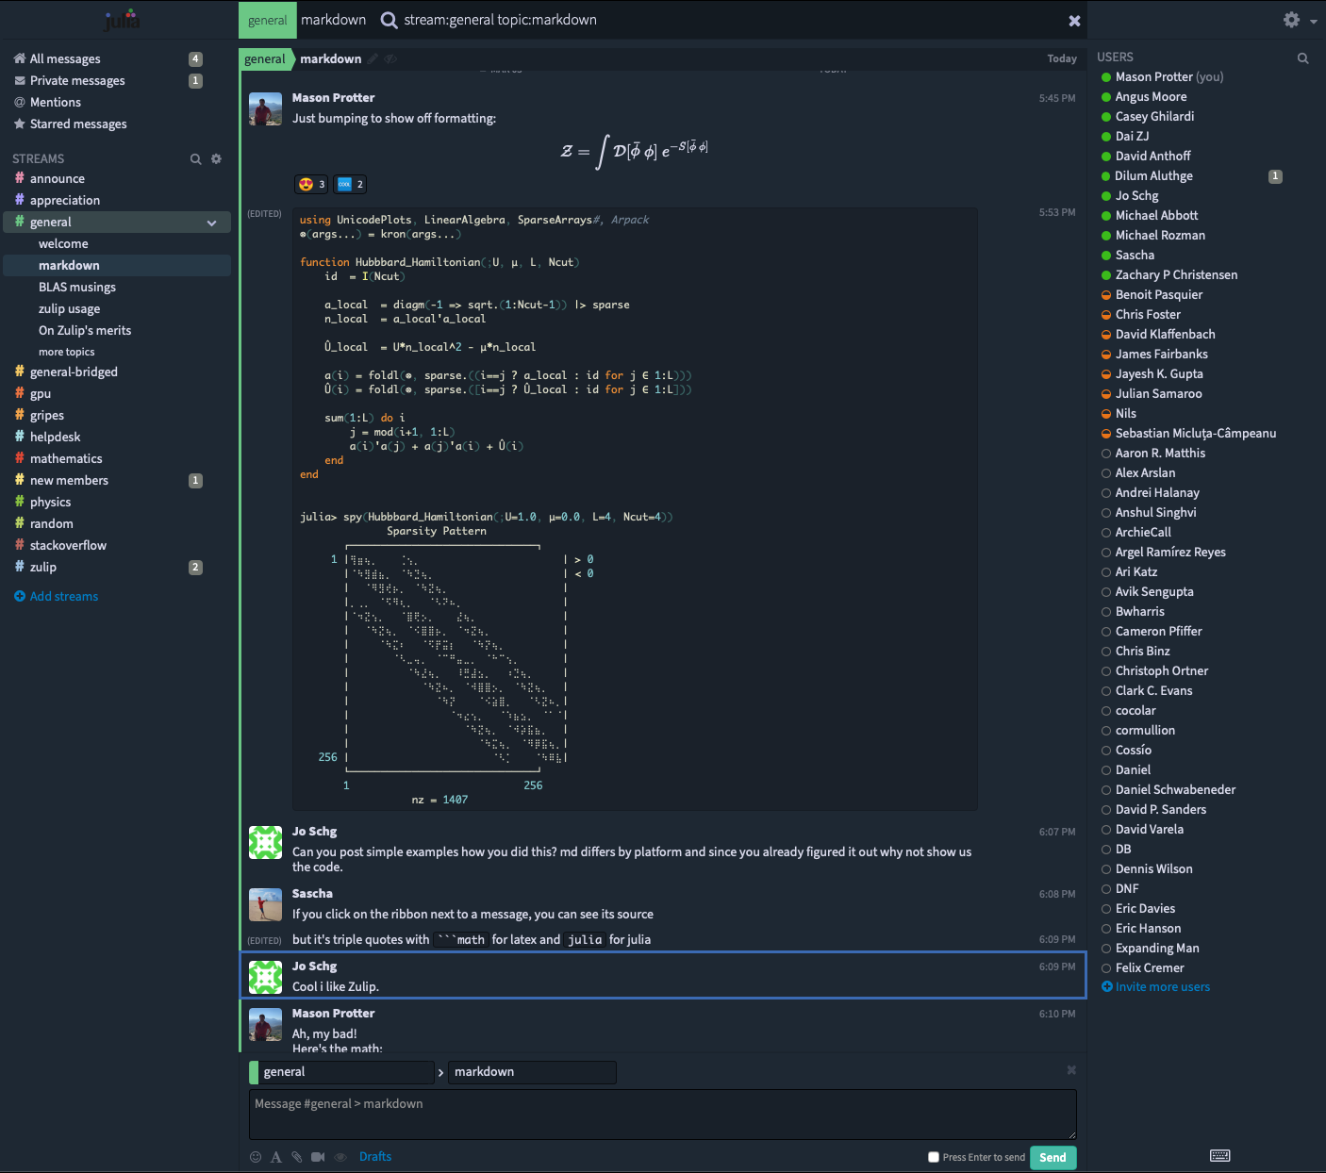
Introduction:
Zulip is an open-source platform that allows users to engage conversations and provides collaborative tools.
We aim to enhance communication and user experience by creating different features.

Slide 3
Gantt Chart

Slide 4
Work Performed so far:
Clear outline for future tasks and roles
Our Gantt chart which is made to help us organize our tasks
Meeting times are clearly communicated and flexible for all members.

Slide 5
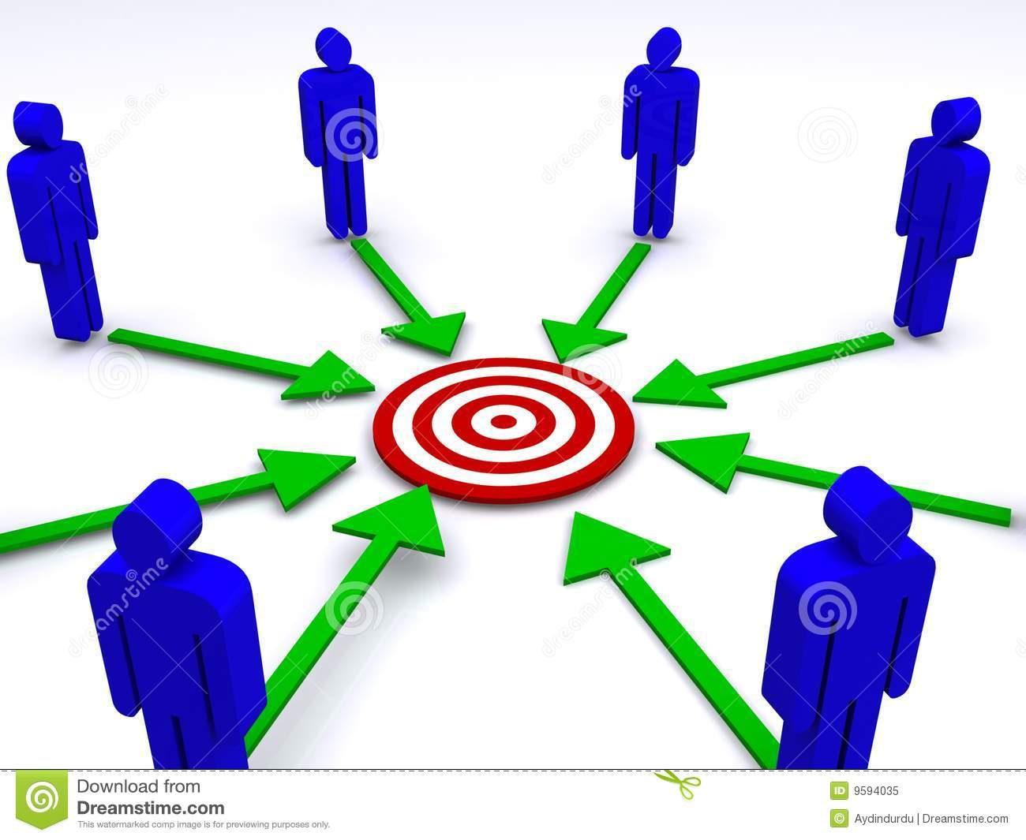
What has gone well:
Team communication
Not much procrastination
Having a clear goal
Notes:
Emily

Slide 6

Challenges:
You were the chosen one! It was said you would push to your own branch, not master!
Life getting in the way
Technology (github) not working as anticipated
Notes:
Emily

Slide 7

Plan for remaining work:
User stories and scenarios for each features.
Think about functional and non-functional requirements of the project
Design the UI
Development:
Make our own branch for development
Develop and test our individual features
Merge into the main branch after completion, resolve conflicts (if necessary)
Documentation
Evaluate the success criteria
User feedbacks

Slide 8
Conclusion:
Elevate Zulip by adding project management tools such as
Work Status
Set Location
Page Customization
Notification
Estimated Budget & Time:
$40,000
12/10/21

